Slide 1

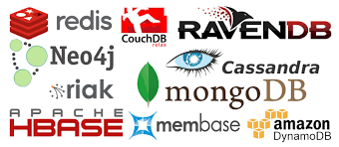
Tech Talk
NoSQL world with MongoDB and CouchDB
http://nosql-database.org/

Slide 2







Objective
Create Awareness
Knowledge
Make Decisions

Slide 3
This Presentation is not for
The Promotion of
NOSQL Databases
MongoDB & CouchDB
BASE instead of ACID

Slide 4
Agenda
NoSQL DBs
Prominent NoSQL Types
SQL Vs NoSQL
CAP - Theorem
MongoDB
CouchDB
MongoDB Vs CouchDB

Slide 5
NoSQL DBs
Not Only SQL
Data store which does not follw relational data model
And does not depend on SQL to retrieve data from db
Why NoSQL?
  One schema does not fit all
  Relational Model has horizontal scaling issues. But NoSQL is Horizontaly scalable.
  Freedom from tyranny(dominance) of DBAs
Merits
    Schema free
  Data Replication - Therefore
    a) Identical
    b) Fault-Tolerant
    c) Partitioned
  No single point failure
  Easy distribution
  Cheap hardwares & Easy Implementation
What it does not
Join
Group By
ACID
Transactions

Slide 6
NoSQL distinguishing charactoristics
Charactoristics:
  Large Volume of Data
  Scalable Replication & Distribution
  a) Potentially thousands of machines
  b) Potentially across the world
  Quick answers for query
  More reads (query) & fewer updates
  Asynchronous inserts & updates
  Schema less
  BASE instead of ACID
  CAP compliance
  Open source Development

Slide 7
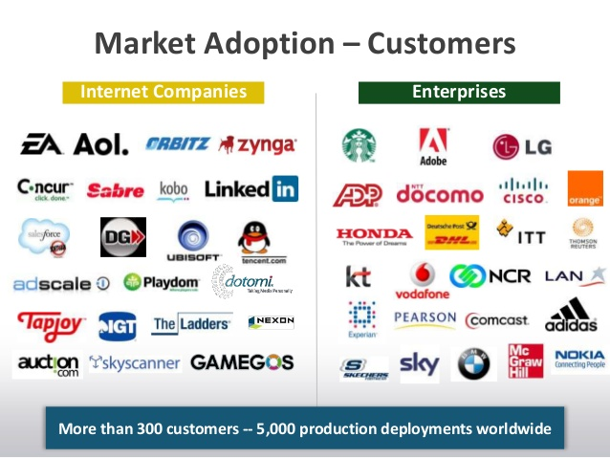
Who are using NoSQL?

Slide 8
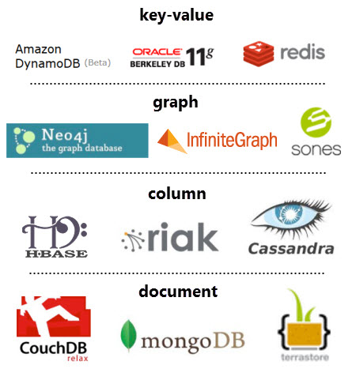
Prominent NoSQL Types
http://nosql-database.org/

Slide 9
Key-Value Stores
Mostly based on Dynamo : Amazon Highly Available Key-Value Store.
Mostly in Memory cache
Write overites entire previous entry
Data Model:
- Global Key-Value mapping
- Basic scalable Hash Map
- Highly fault tolerant
Examples:
Amazon Dynamo, Redis etc.,
Pros
- Simple
- Scalable
Cons
- Can't create your own Foreign Keys
- Poor for complex data models

Slide 10
Graph Databases
An abstract set of objects where some pairs are connected thru some links
Data Model:
- Nodes & Relationships
Examples:
Neo4j, Infinitegraph, OrientDB etc.,
Pros
- Powerful data model, as general as RDBMS
- Connected data are locally indexed
- Easy to query
Cons
- No Sharding
- Rquires rewiring

Slide 11
Column Family
Mostly based on Big-Table: Google's distributed system of structured data
Data Model:
- A Big table with column family
- Map-Reduce for Querying & Processing
Examples:
HBase, Cassandra etc.,
Pros
- Supports semi-structued data
- Naturally indexed
- Scalable
Cons
- Poor for interconnected data

Slide 12
Document Databases
Stores data as JSON document either as collection or directly as document
Data Model:
- Collection of Document
- Docuemnt is a key-value collection
- Index-centric
- Map-Reduce
Examples:
CouchDB, MongoDB etc.,
Pros
- Simple, Powerful data model
- Scalable
Cons
- Poor for interconnected data
- Query model limited to indexes & keys
- Map Reduce for larger queries

Slide 13
What Should Your Application Use?
Key Value DB
To operate on data structures like lists, sets, queues, publish-subscribe then look at Redis. Useful for distributed locking, capped logs, and a lot more
To cache or store BLOB data then look at a Key-value store
Columnar DB
Support for secondary indexes so you can look up data by different keys then look at relational databases and Cassandra's new secondary index support.
Built-in search then look at Riak
Graph DB
To dynamically build relationships between objects that have dynamic properties then consider a Graph Database because often they will not require a schema and models can be built incrementally through programming.

Slide 14
What Should Your Application Use?
Document DB
To build CRUD apps then look at a Document database, they make it easy to access complex data without joins
To support large media then look storage services like S3. NoSQL systems tend not to handle large BLOBS, though MongoDB has a file service.
To work on a mobile platform then look at CouchDB/Mobile couchbase.
Document DB / Key value DB
Always be able to write to a database
Programmer friendliness in the form of programmer friendly data types like JSON, HTTP, REST, Javascript then first look at Document databases and then Key-value Databases.
Fluid data types because your data isn't tabular in nature, or requires a flexible number of columns, or has a complex structure, or varies by user (or whatever), then look at Document, Key-value
http://highscalability.com/blog/2011/6/20/35-use-cases-for-choosing-your-next-nosql-database.html

Slide 15
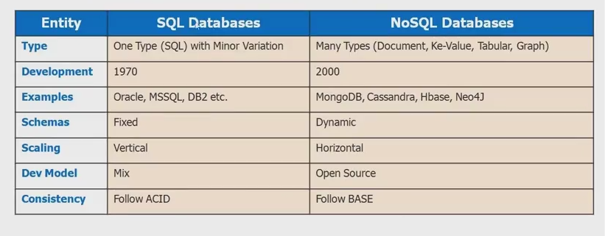
NoSQL Vs SQL

Slide 16
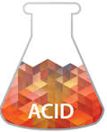
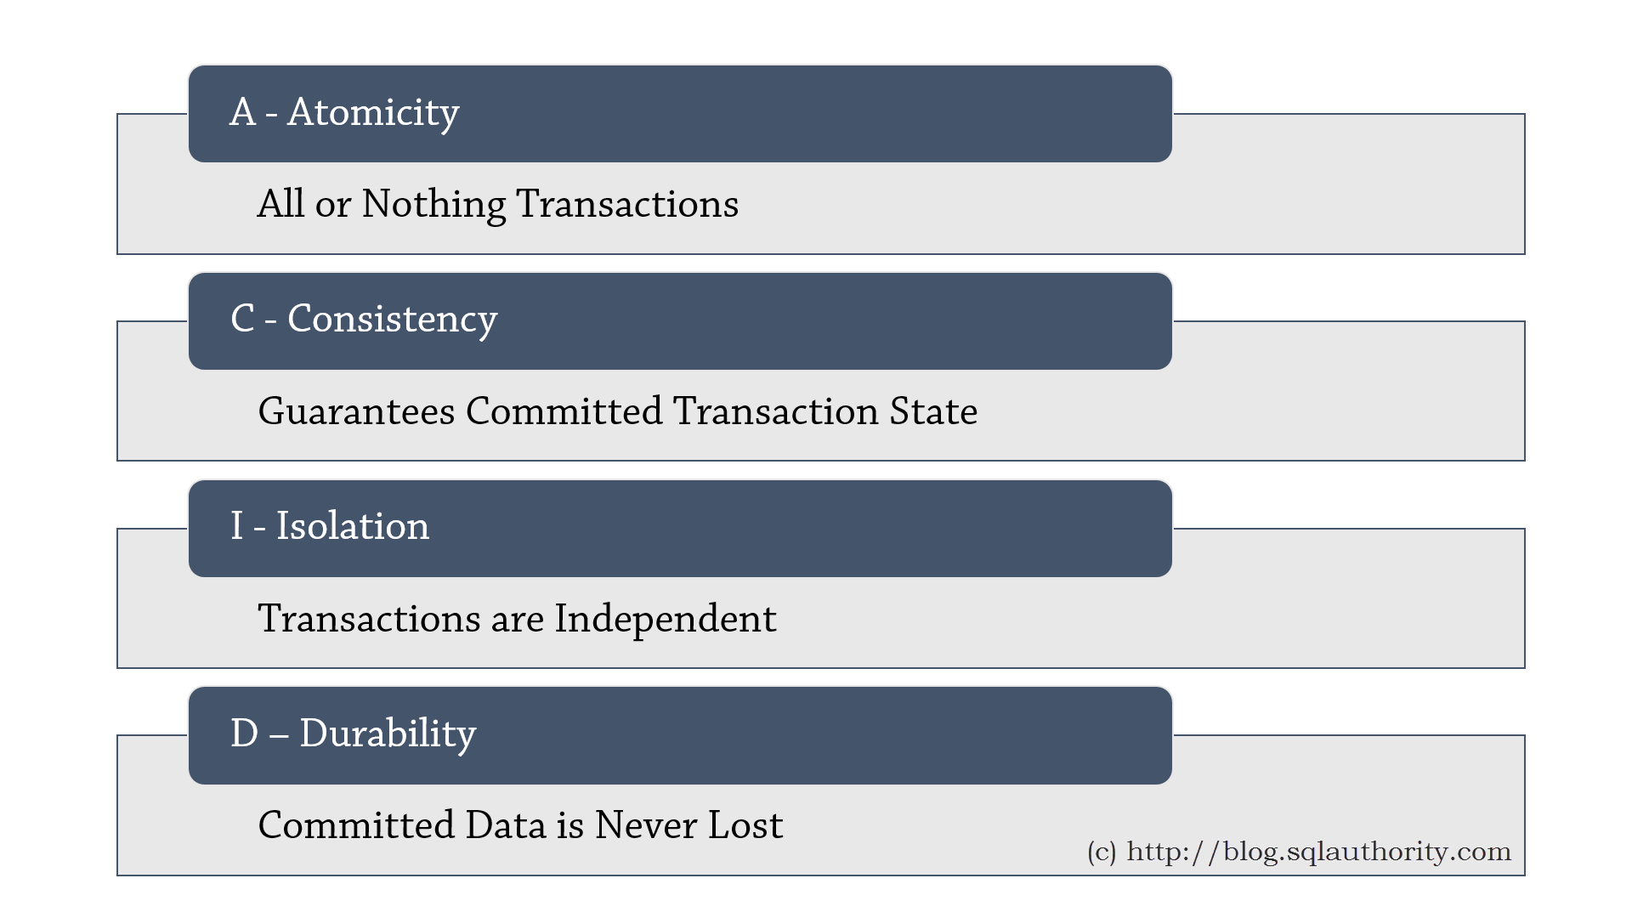
ACID
Basically for Data Transaction & Safety
Note: All Relational DBMS ACID compliant

Slide 17

BASE
Provides set of rules for ..
Distributed Database Systems
B - Basically Available
S - Soft sate : Even the data is not
persisted in disk, yet in case of
failure data can be restored.
E - Eventual Consistency
Note: 1. NoSQL DBs are BASE compliant
2. ACID consistency - Transaction brings DB
from one valid state to another.
3. BASE Consistency - Eventual consistency
(exactly data replication)

Slide 18
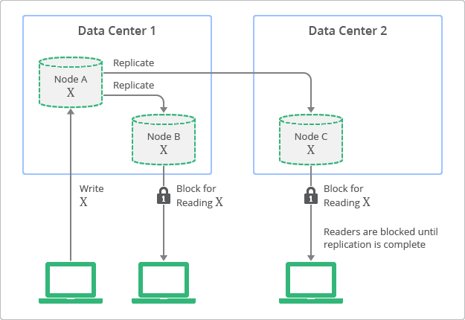
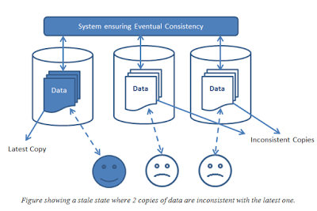
Strong Consistency
Eventual Consistency

Slide 19
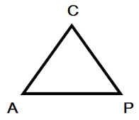

Slide 20
CAP - Theorem
CAP describes the trade-offs involved in “Distributed Database Systems”
It is impossible for a “Distributes Database System” to provide following three guarantees at the same time:
C - Consistency
A - Availability
P - Partition-tolerance

Slide 21
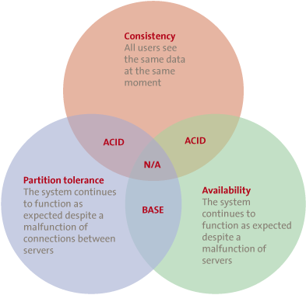
CAP - Theorem
Consistency - All server answers with same data
Availability - System always responds either with
i) approximate data / old data
II) @least a message saying - system down
II) consistent response across system
Partition Tolerance - Node failures do not prevent survivors from continuing to operate

Slide 22
Why CAP is important?
Distributed Database Systems - are the Future
CAP describes the trade-off involved in
Distributed Data Systems
Understanding of CAP helps to take decision
on designing Distributed Data Systems
Misunderstanding can lead to
erroneous or inappropriate design choices

Slide 23
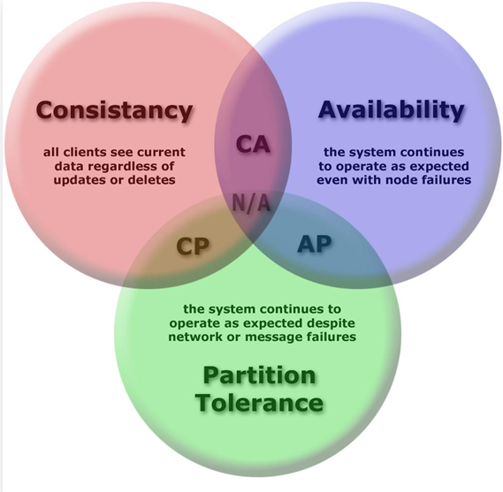
CAP in nutshell
Only 3 possible Distributed Data Systems
CA
CP
AP
CP & AP are the most prefered for Distributed Data Systems, Since
“Of the CAP theorem’s Consistency, Availability, and Partition Tolerance, Partition Tolerance is mandatory in distributed systems.
You cannot not choose it.”

Slide 24
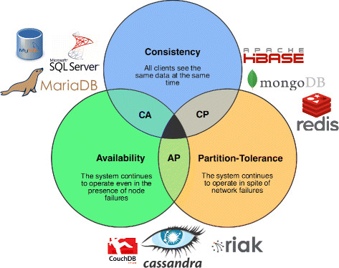
Decision is Yours
CAP compliance of SQL & NoSQL

Slide 25
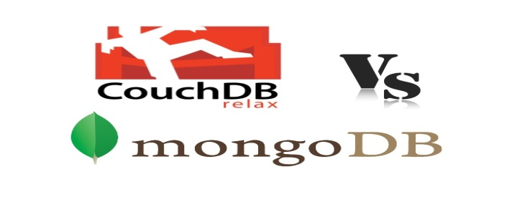

Slide 26
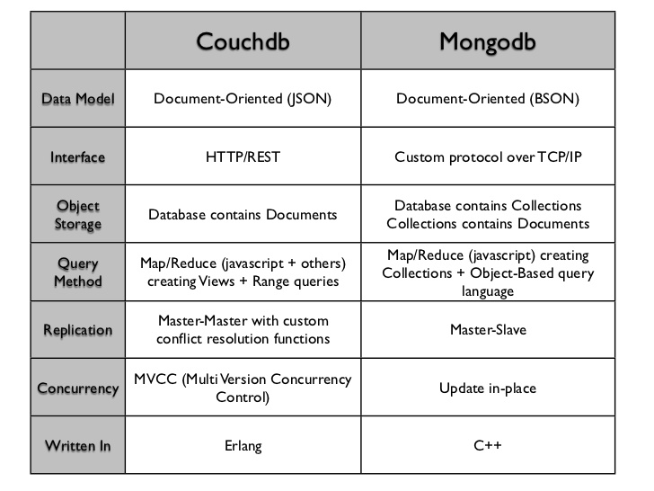

Slide 27
Summary (How to Choose)
Do you need master-master? Then CouchDB.
Do you need MAXIMUM R/W throughput? Then MongoDB.
Do you need ultimate single-server durability because you are only going to have a single DB server? Then CouchDB.
Are you storing a MASSIVE data set that needs sharding while maintaining instant throughput? Then MongoDB.

Slide 28


Slide 29
version 3.2.8
1. Features
2. Installation
3. Configuration
4. GridFS API
5. Robo Mongo UI

Slide 30
version 3.2.8
Features:
1. easy & simple admin/dev
2. sharding
3. master-slave replication
4. Capped collections
4. Gridfs - file storage mechanism for media files as well
5. Cloud & HDFS Integration
    MongoDB comes with a JavaScript shell that allows interaction with MongoDB instance from the command line.

Slide 31
Sharding
Sharding - Process of storing data records across multiple machines
Why Sharding?
  In replication all writes go to master node
  Latency sensitive queries still go to master
  Single replica set has limitation of 12 nodes
  Memory can't be large enough when active dataset is big
  Local Disk is not big enough
  Vertical scaling is too expensive

Slide 32
Capped Collection
Capped Collection
Creating collection with
capped(boolean)
size (# in bytes)
max(# of documents)
autoIndexId (boolean) - (true in
replication mode)
validationLevel (off,strict,moderate)
validationAction (error,warn)
Syntax: db.createCollection("my_capped_collection", { “capped” : “true”, “size” : “2097152”, “max” : “5000”, “autoIndexId” : “true”, “validationLevel” : “moderate”, “validationAction” : “warn” } )

Slide 33
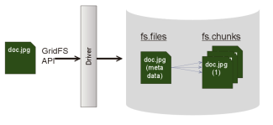
GridFS: Storing Files
  GridFS is a mechanism for storing large binary files in MongoDB.
  Note: -BSON-document size limit of 16 MB.
  Instead of storing a file in a single document, GridFS divides the file into parts / chunks (256 KB)
  Note: In MongoDB 2.4.10: Chunk size 256 kB to 255 kB.
    Why using GridFS
      •To Store user generated file content
      • Storing document greater than 16MB
      •Overcoming file system limitations.
      • You can get great disk locality with GridFS, because MongoDB allocates data files
      in 2GB chunks.

Slide 34
Installation & Configuration & Basic Mongo shell commands
GridFS API Implementation

Slide 36
version 1.6.1
1. Features
2. Installation
3. Configuration
4. Futon
5. Java with couch4j driver

Slide 37
version 1.6.1
Couch is an acronym for cluster of unreliable commodity hardware
Features:
1. ACID Semantics - It does thru can handle a high volume of concurrent
readers and writers without conflict
2. Built for Offline
3. Master-To-Master replication. N-Master replication
4. Mobile platform support. It has installer for IOS &
Android (PouchDB)
5. Http REST JSON only. No binary protocol
6. Map/Reduce Views and Indexes
7. Documents can have attachment
8. Futon web interface.
9. Cloud Integration

Slide 38
Installation & Play around with Futon web interface
with Java & couch4j

Slide 39
Thank You
By
Arul

